Slide 1
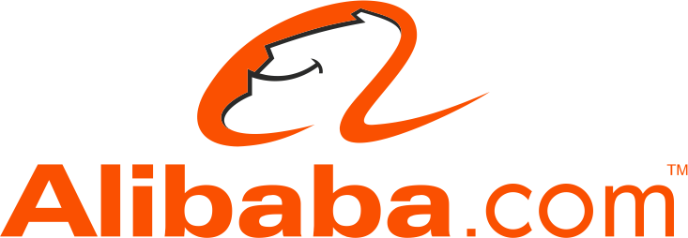
Alibaba.com: A Smiling Community with a Dream
ELIZABETH LUST

Slide 2
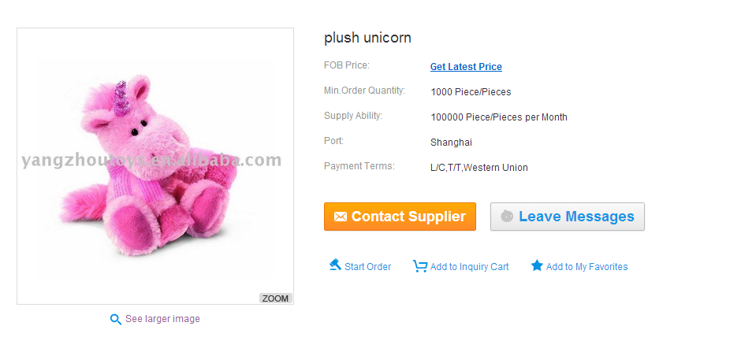
What exactly is Alibaba?

Slide 3

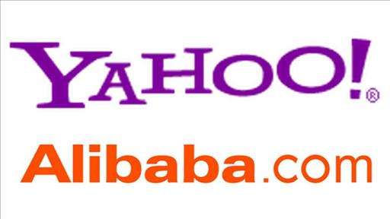



Alibaba Group
Alibaba.com- Int’l B2B
Alipay.com-Chinese Paypal
Yahoo! China
Alisoft-Chinese Business Software
Alimama.com- Chinese Advertising
Taoboa.com- Chinese B2C and C2C
AliExpress.com- Int’l B2C

Slide 4
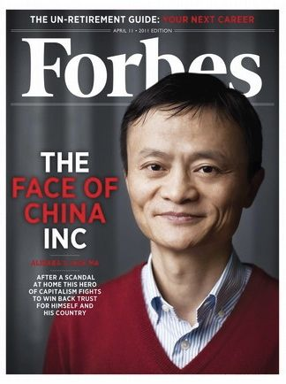
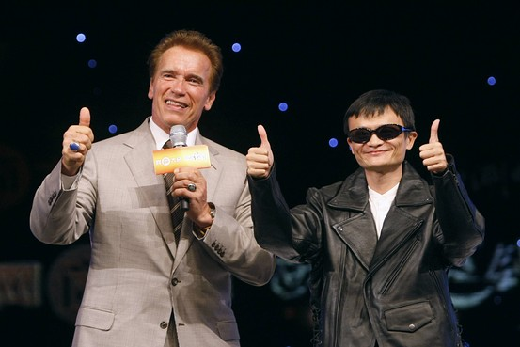
Jack Ma- Founder and CEO
One of the first e-commerce entrepreneurs in china
Started Alibaba in 1999
Company will retain “start up” mentality
Known as quirky and disruptive
“Smells” all departments
Resigned from Alibaba May 10 2013

Slide 5
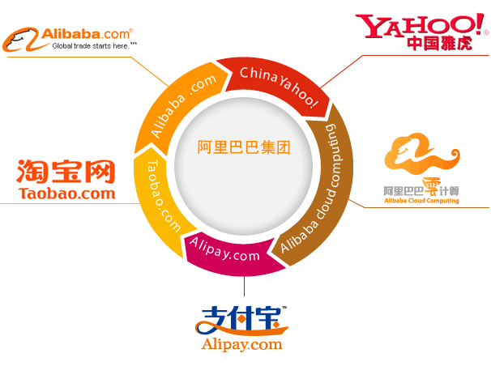
Company Values
Customers are everything
Team interests are always ahead of individual interests
Go beyond yourself and welcome changes
Honest and upright, honoring commitments
Never give up and stay optimistic
Perform the extraordinary with a professional attitude and an ordinary mind

Slide 6

Work Environment
Blue Sky
Solid Ground
Free-flowing Ocean
Green Forest
Harmonious Community

Slide 7
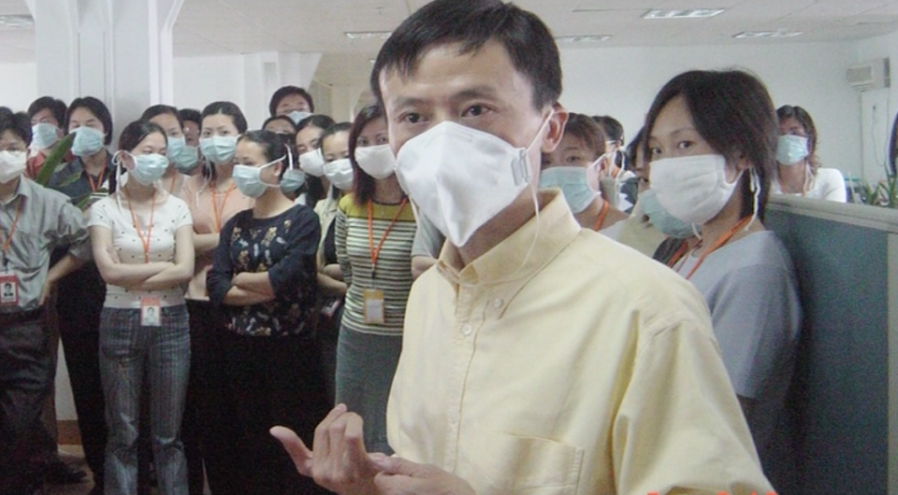
Leadership
Leadership Priority
Value Alignment
Stretch opportunities and challenges
Wealth creation and sharing
Transparency and communication
Alibaba Day

Slide 8
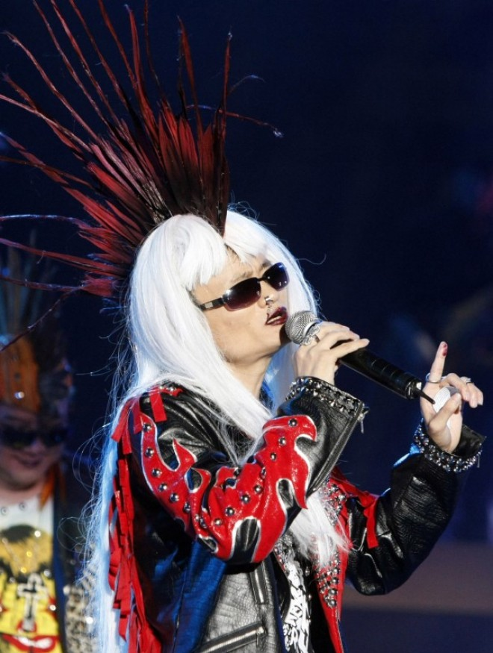
Requirements for Employees
People with a dream
People with shared values
People with a smile
People who enjoy work and can turn stress
and challenges into innovation
People who can work together
2011 Scandal

Slide 9
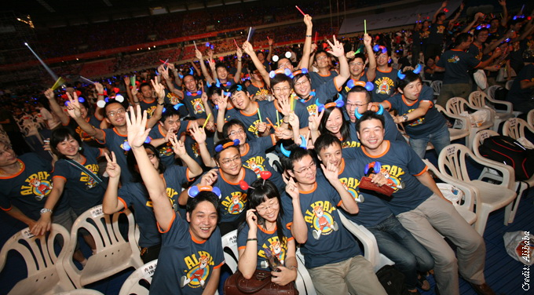
From the eyes of Employees
A leader with charisma and credibility
Opportunity to make and difference by developing a new way of doing business
Sense of ownership and entrepreneurial spirit
Culture that is real
Changes, challenges, and growth
Communication and Transparency
A company that cares about employees

Slide 10
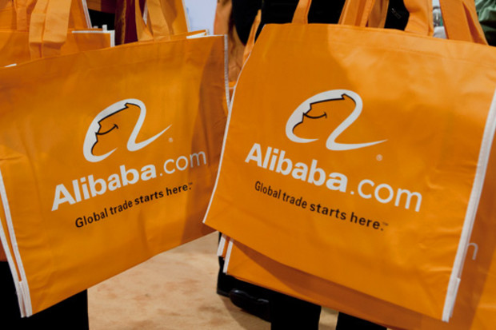
IPO
This month Alibaba announced plans
to go public on US stock market
Company is valued over $130 billion
(higher than Facebook, Amazon, and
eBay) making it the largest IPO
of all time

Slide 11
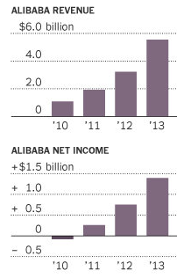
Currently
2013
Net income of $3.56 billion
Revenue of $7.65 billion
Profit margin of 45%
eBay has a profit margin of 17.8%
At least 20% of current sales are mobile

Slide 12
Quiz
1. How did the CEO of Alibaba make sure that departments are running smoothly?
a. Smelling
b. Regular meetings
c. Trusted his managers
2. What is most important to Alibaba?
a. Profits
b. Values
c. Current Employees
3. What is the name of their B2C company?
a. Taoboa
b. Alipay
c. AliExpress

Slide 13
Sources
http://im.ft-static.com/content/images/c6aba388-74a6-11db-bc76-0000779e2340.pdf
http://money.cnn.com/2014/05/06/investing/alibaba-ipo/
http://en.wikipedia.org/wiki/Alibaba_Group#Research_and_development
http://www.wikinvest.com/stock/Alibaba.com_(ALBCF)
http://dealbook.nytimes.com/2014/05/06/alibaba-files-to-go-public-in-the-u-s/?_php=true&_type=blogs&_r=0
http://online.wsj.com/news/articles/SB10001424127887323826704578353541903974624
http://online.wsj.com/news/articles/SB10001424127887324235104578243093632137754
http://www.forbes.com/forbes/2011/0411/features-jack-ma-alibaba-e-commerce-scandal-face-of-china.html
http://www.washingtonpost.com/blogs/the-switch/wp/2014/05/07/alibaba-founder-jack-ma-once-sang-can-you-feel-the-love-tonight-in-full-hair-metal-regalia/
http://finance.fortune.cnn.com/2013/04/26/alibaba-ipo/

